Slide 1
Poincaré Embeddings for Learning Hierarchical Representations
Krzysztof Kolasiński, 5.09.2017

Slide 2
Content
Introduction with word embeddings
What’s wrong with w2v?
The need of hyperbolic spaces
Understanding Poincare embeddings
Disclaimer
Not expert in Riemannian optimization methods
Quite hard mathematics behind
My point of view on some problems, not stated in literature

Slide 3
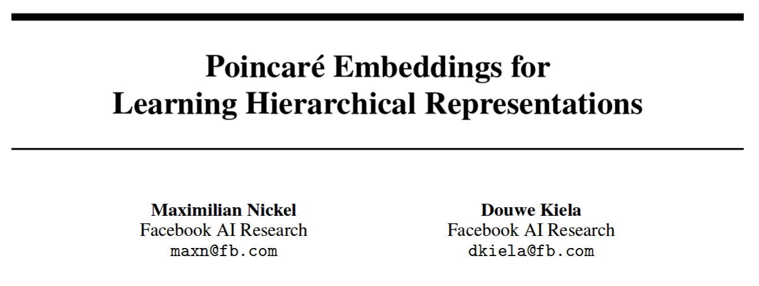
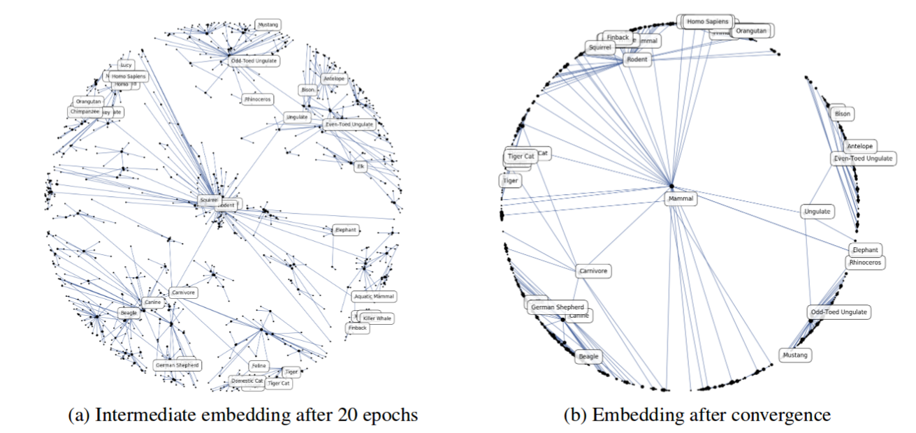
Poincaré Embeddings for Learning Hierarchical Representations (22 May 2017)

Slide 4
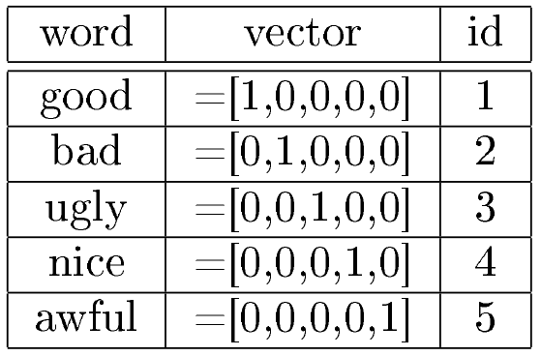
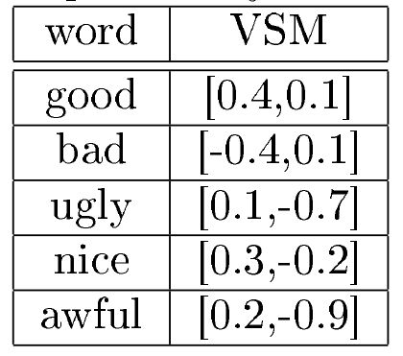
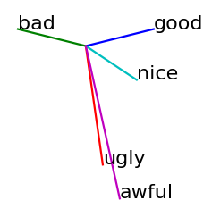
Vector representation of words - motivation
Word embeddings (toy example):
Why word embeddings:
We want to embed high dimensional vectors in low dimensional space
We want to have meaningful vector representations

Slide 5
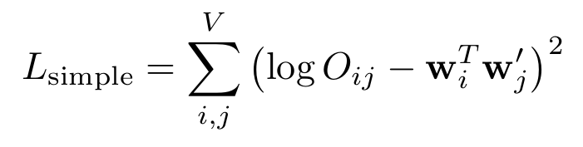
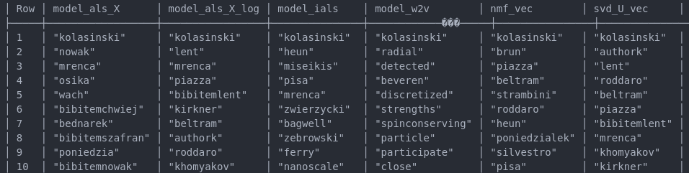
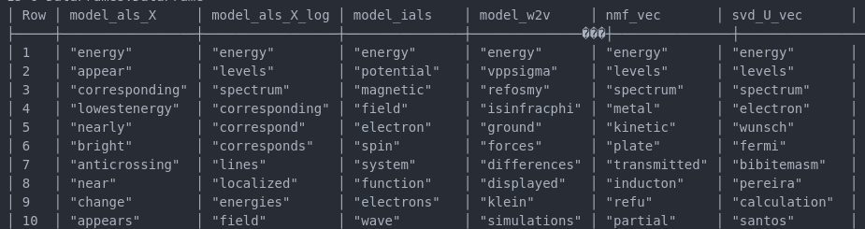
Simple implementation of Glove algorithm
Word: kolasinski
Word: energy

Slide 6
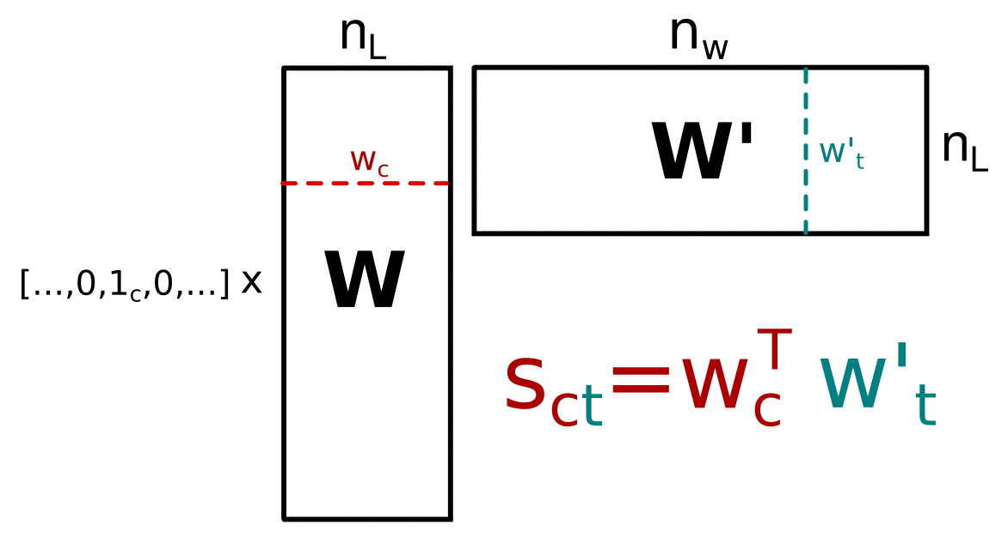
Word2vec basic ideas
Distributional Hypothesis - states that words that appear in the same contexts share semantic meaning
It’s a predictive algorithm - based on local co-occurrence
One word context
This is nothing else like shallow neural network with one hidden layer:
“the quick brown fox jumped over the lazy dog”
We start from creating context/target pairs: (the : quick, quick : brown, brown : fox, ...)
The words are converted to sparse orthogonal representation: (1 : 2, 2 : 3, 3 : 4, ...)
For each input word k we will maximize the probability of that the target word (brown) will appear after context word (quick) i.e. we want to maximize score s_{kp}.

Slide 7
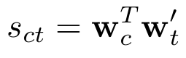
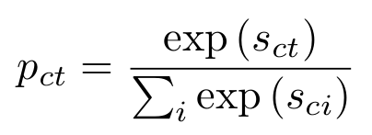
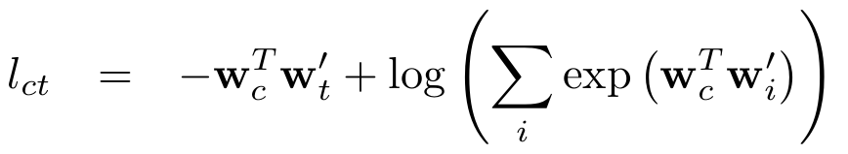
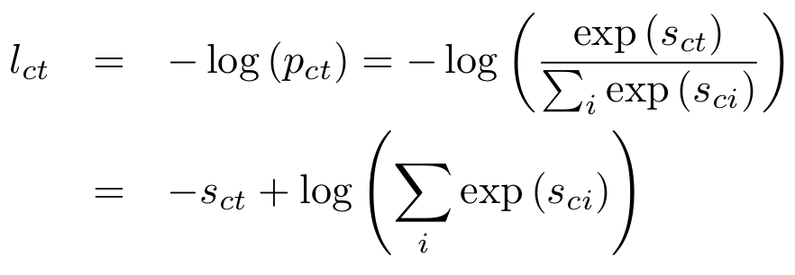
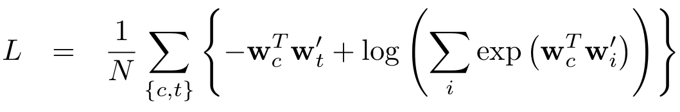
Word2vec basic ideas
One word context
“the math”
For a given context/target pair we compute score
The probability of observing word p for given input word k is computed with Softmax
The same but expressed in terms of W and W’ matrices
The context/target pair loss is defined as
Total loss is defined as

Slide 8
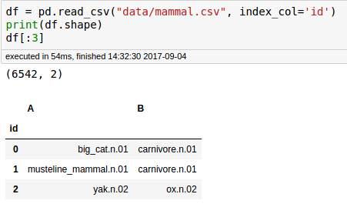
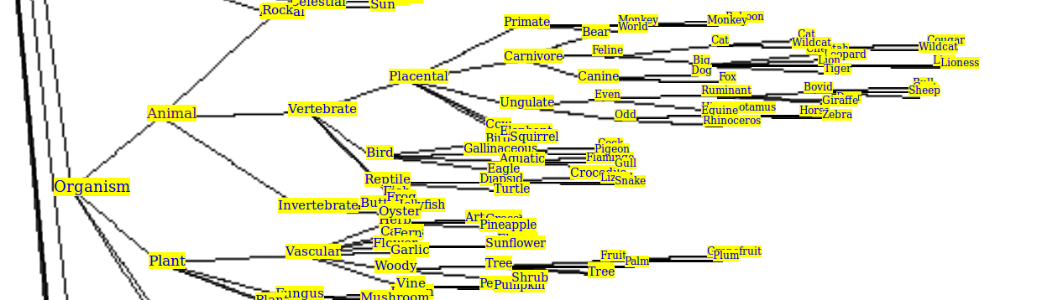
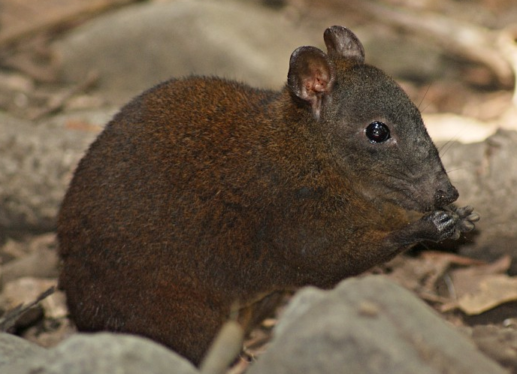
Word2vec basic ideas - in practice
Take your text and prepare word pairs table:
Example fragment of wordnet tree
Example pairs from the tree are (same for every mammal noun)
('musk_kangaroo', 'mammal')
('musk_kangaroo', 'metatherian') ('musk_kangaroo.n.01', 'marsupial.n.01'), ('musk_kangaroo.n.01', 'kangaroo.n.01')
This gives: 1181 unique nouns

Slide 9
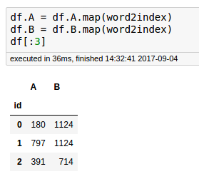
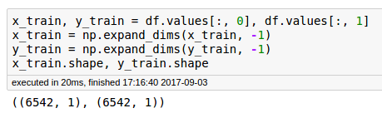
Word2vec basic ideas - in practice
Take your text and prepare word pairs table:
Example fragment of wordnet tree
2. Convert to indices
Create dataset for keras

Slide 10
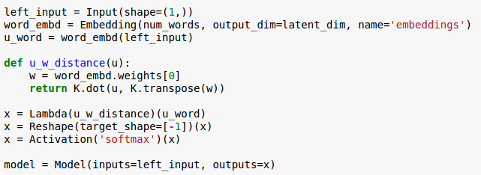
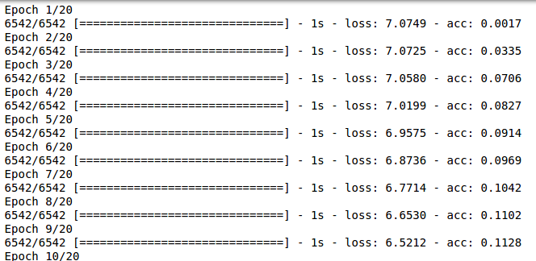
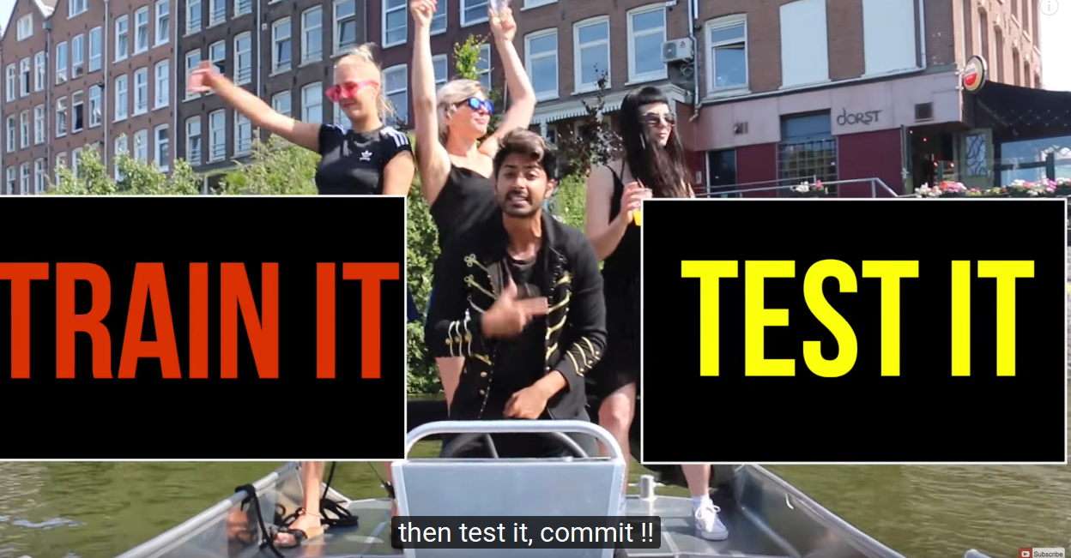
Word2vec basic ideas - in practice
3. Define ultra simple model:
4. Train model

Slide 11
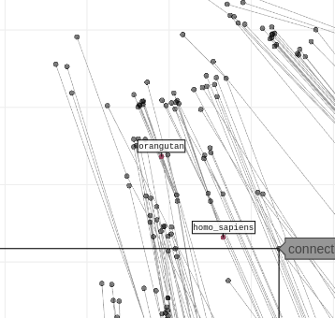
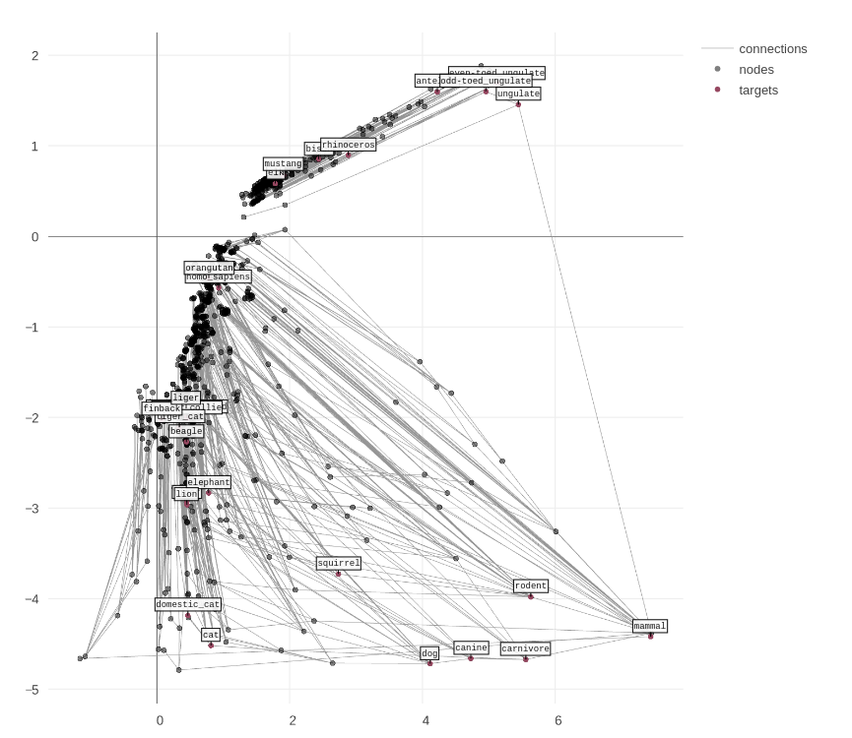
Word2vec basic ideas - in practice
5. Test it!
Where is the problem?

Slide 12
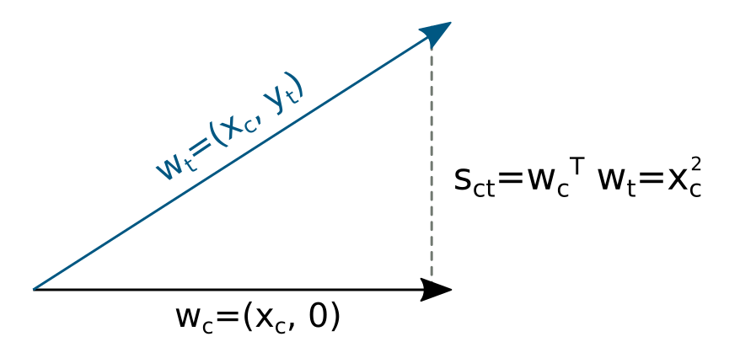
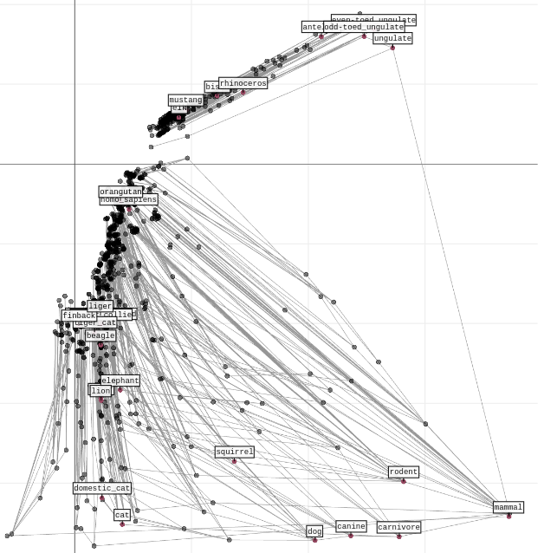
Word2vec basic ideas - limitations
Where is the problem?
The definition of the score is a dot product:
Any ideas for solution?
note the structure
In consequence, infinitely separated points may result in same score...

Slide 13
Word2vec basic ideas - limitations
Where is the problem?
Any ideas for solution?
The definition of the score is a dot product:
Normalization over all words - this leads to the loss from synonymes:
Consider two similar words, they will lead to the same score hence low p_{ct}

Slide 14
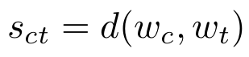
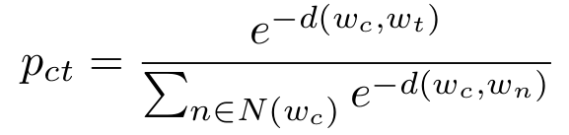
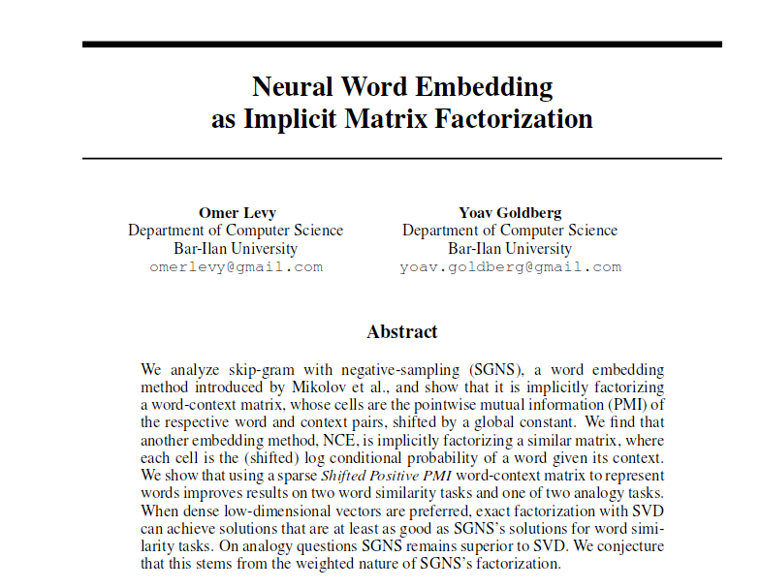
Word2vec basic ideas - limitations
Possible solutions:
Redefine score function, to distance function:
Use sampling (clever one may reject synonyms from sampling):
Use different learning scheme (discussed later) e.g. matrix factorization for Poincare embeddings.
Things worth to check:
Same things may happen in image classification, maybe a clever sampling of softmax function is not a bad idea?
We are going to use predictive approach for computing word vectors, however maybe there is a possibility to derive count based method for general distance? Like in the paper below:

Slide 15
Moving to hyperbolic spaces

Slide 16
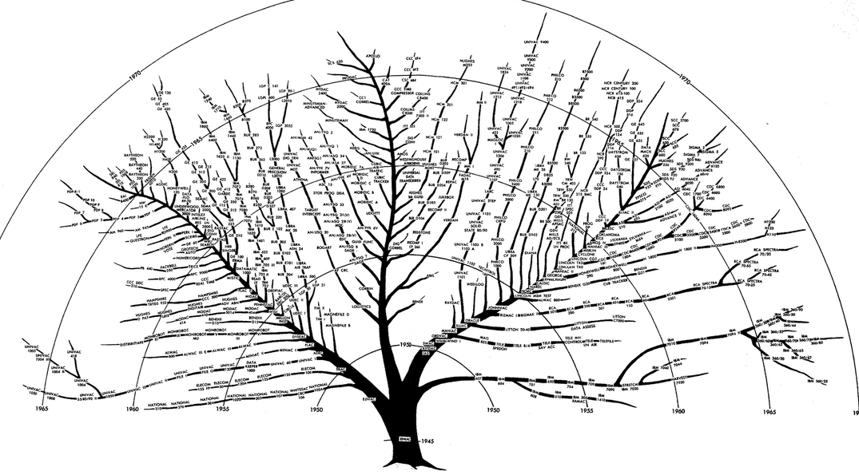
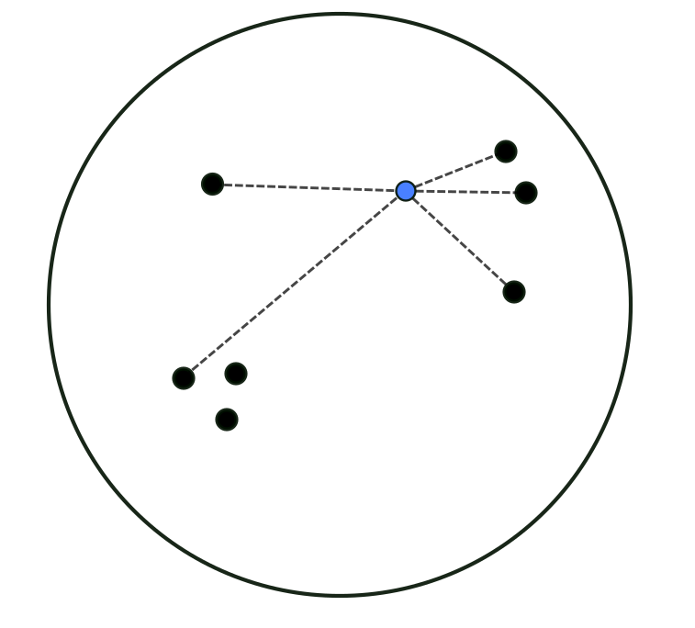
Poincare embeddings - big picture
In Euclidean space those things are close
Use distance function instead of inner product
Image we want to embed complex tree structure in planar space

Slide 17
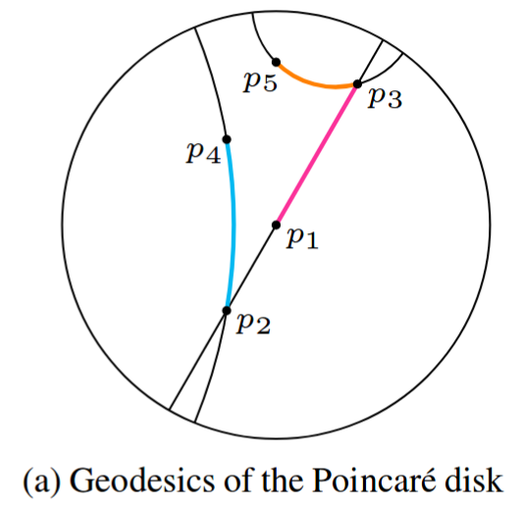
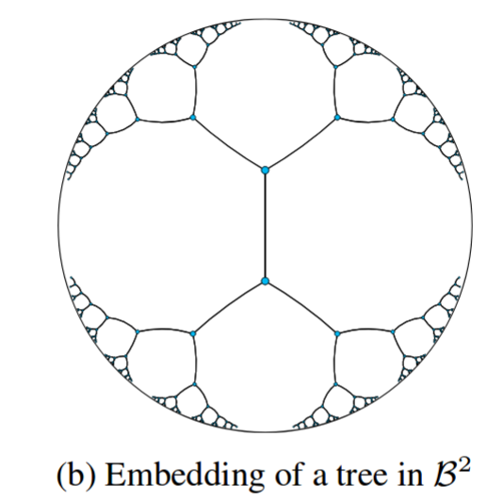
Poincare embeddings - big picture
The idea is to use the hyperbolic space instead euclidean one
“hypertree“
Euclidean space
In Poincare model of hyperbolic space:
The circle represents the surface of infinite area
Geodesics are circles perpendicular to the boundaries
Example of non-euclidean geometry: violation of 5th Euclid's postulate: the parallel postulate
can be viewed as continuous version of discrete trees

Slide 18
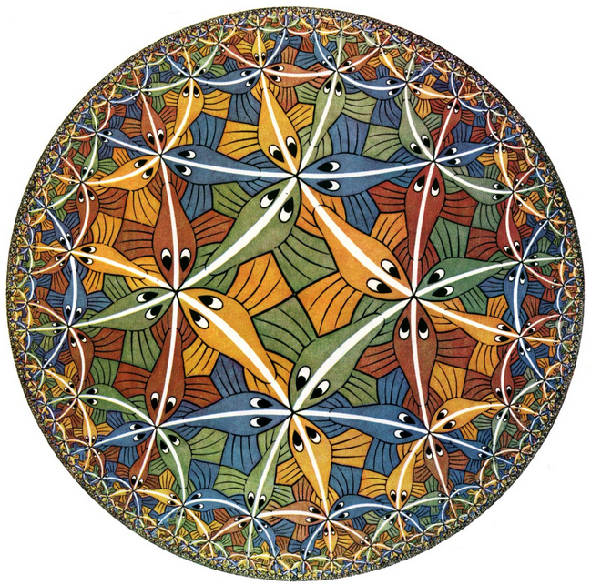
Poincare embeddings - big picture
The idea is to use the hyperbolic space instead euclidean one
from Escher:
each fish has the same area

Slide 19
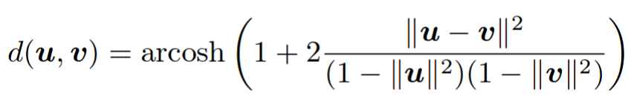
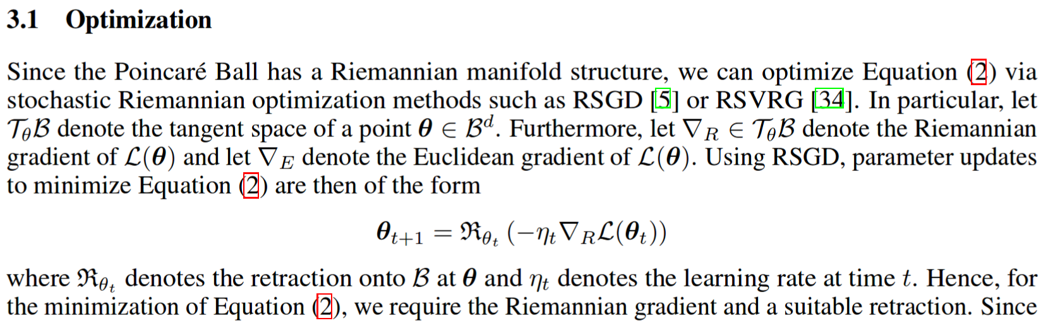
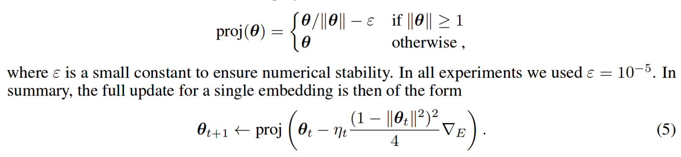
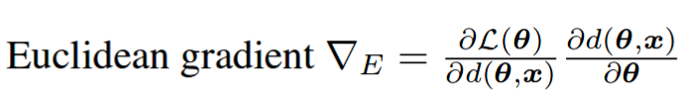
Poincare embeddings - big picture
Distance in disc model is given by equation:
The authors provide optimization method
Which simplifies to:

Slide 20
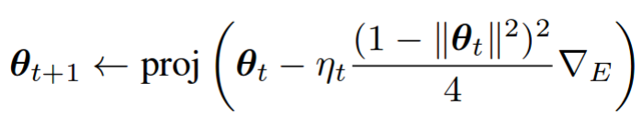
Poincare embeddings - big picture
The basic algorithm for Keras would be:
Take w2v simple model
Replace inner product with distance
Compute sampling
Compute gradients with SGD, multiply it by factor and project
This step requires writing custom optimizer or extending existing one, but that is simple

Slide 21
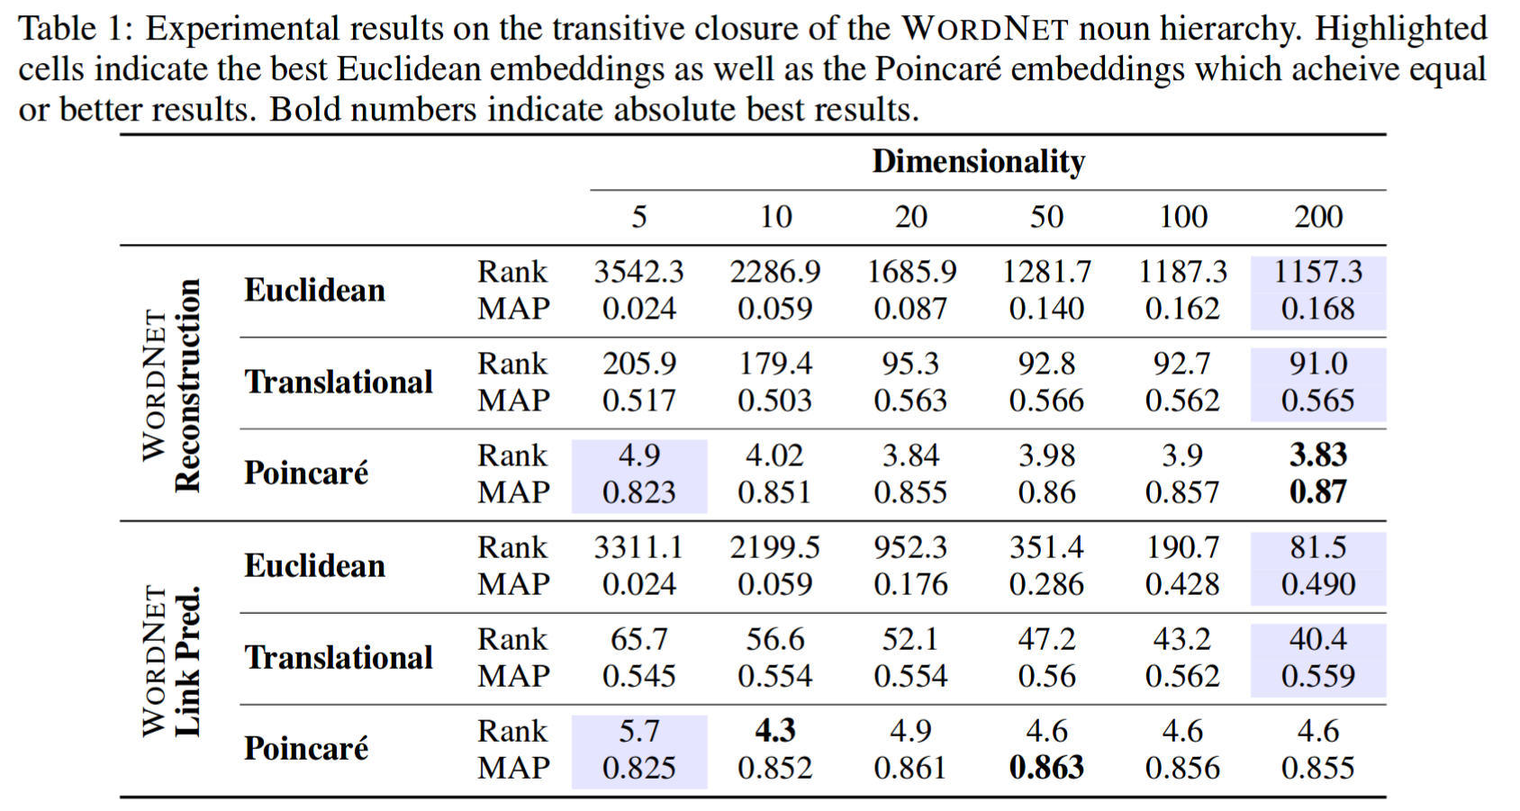
Poincare embeddings - results
Selected results:

Slide 22
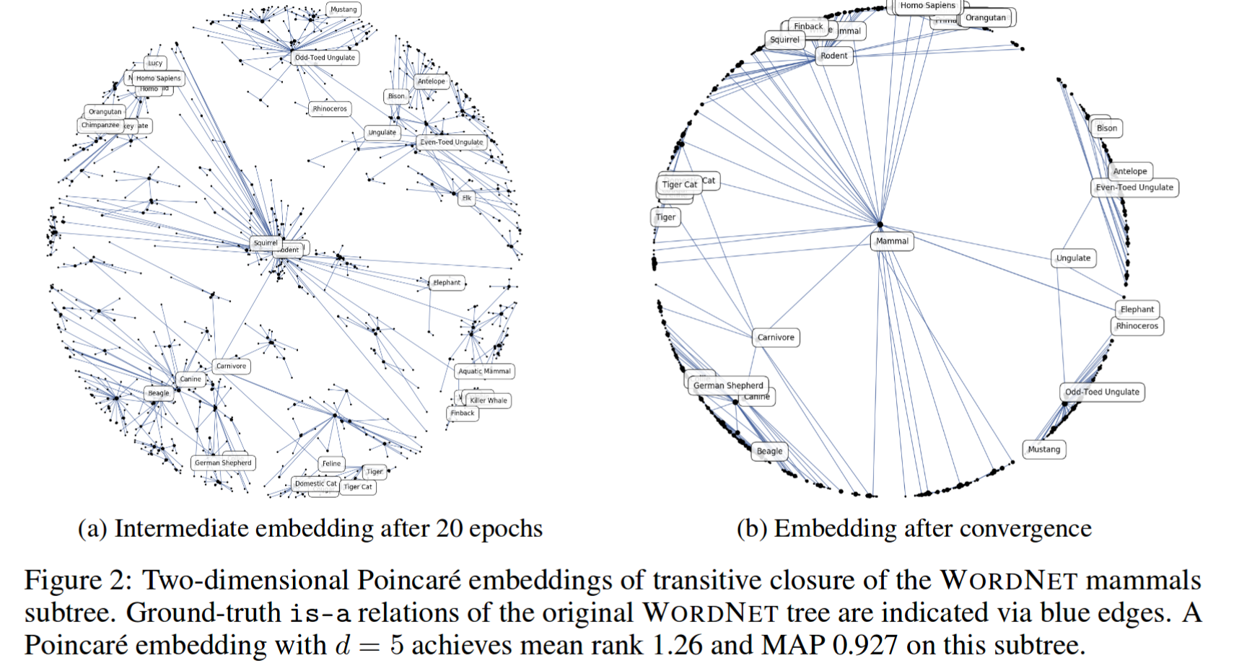
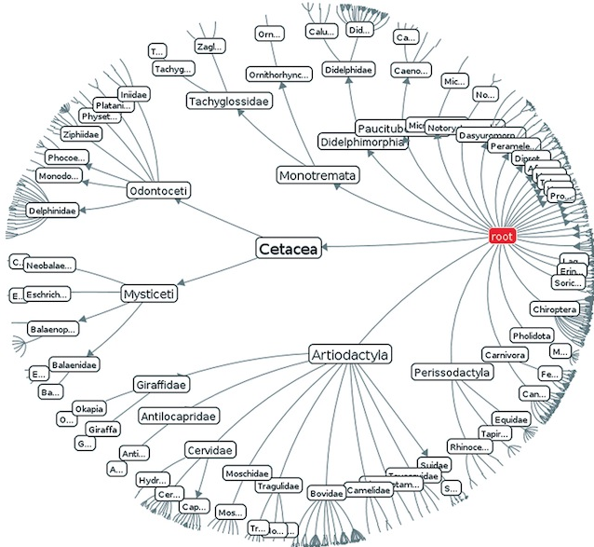
Poincare embeddings - results
Selected results: on mammal sub-tree
compare with that thing obtained with inner product
compare with example generated hypertree

Slide 23
Understanding Poincare embeddings

Slide 24
Understanding Poincare embeddings
We are going to answer the following questions (with limited number of math)
Why the shortest path is not the straight one?
What is a metric space ?
What is natural gradient ?
What is blablabla ...
For now let’s us assume that we know what is Poincare model of hyperbolic space

Slide 25
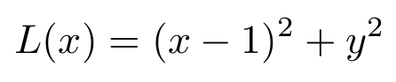
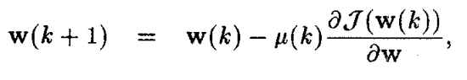
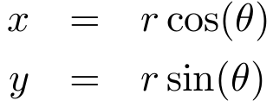
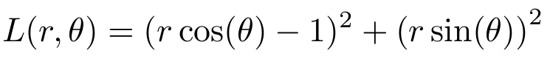
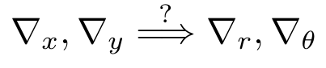
Understanding Poincare embeddings: Euclidean space
Consider following problem (check out the paper in the link!!!)
Find minimum of that function using gradient descent
Let’s re-parameterize our problem with following mapping:
Our gradients will change with new parametrization
This is no more valid

Slide 26
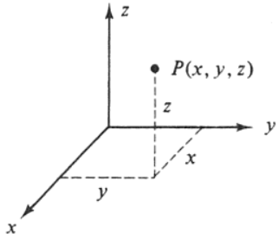
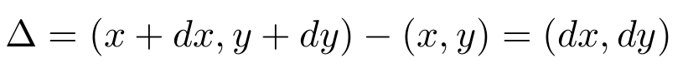
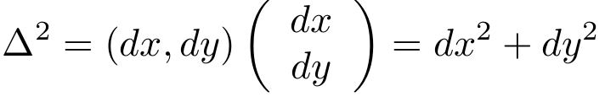

Understanding Poincare embeddings: Riemannian space
We are going to derive general stochastic gradient descent for arbitrary spaces
In Euclidean space the (x, y) coordinate system is orthonormal
polar coordinates
The infinitesimal translation is given by
With squared length - “the interval”:
The increment in x by change in transformed frame
x
from this we can compute interval in new coordinate frames

Slide 27




Understanding Poincare embeddings: Riemannian space
We are going to derive general stochastic gradient descent for arbitrary spaces
With squared length - “the interval”:
polar coordinates
Riemannian metric tensor
In polar coordinate frames the interval depends on position!!!
In general we write:
for polar case

Slide 28







Understanding Poincare embeddings: Riemannian space
Consider following problem
We are looking for general expression for gradient update for arbitrary spaces
Standard question: which direction of du minimizes L at most?
We put
with constraint
By the Lagrangean method, we want to minimize this with condition on n
update direction

Slide 29

Understanding Poincare embeddings: Riemannian space
Consider following problem
We are looking for general expression for gradient update for arbitrary spaces
The gradient descent update is then:
This equation is called natural gradient descent
Euclides gradient: same as computed by Keras
Metric generated by parametrization of Euclidean space in our case

Slide 30

Understanding Poincare embeddings: paper
Let’s go back to the paper for a while and see what we know so far:
the distance, not discussed yet, but it is induced by metric tensor
The authors provide optimization method
Metric tensor for Poincare model - done - we know that it may come from some parametrization of space? what space - not euclidean...
Retraction - projects gradient into Poincare Ball - here they used simple update (u + grad) leading to natural gradient method.
Which simplifies to:
projection - keeps params in Poincare Ball
natural gradient

Slide 31

Understanding Poincare embeddings: Toy example
Consider following problem
Using natural gradient method:
Gradients
Natural gradient
here is the minimum
Note that this plot is in polar coordinates

Slide 32

Understanding Poincare embeddings: The distance
Comparison between standard gradient and natural one
It seems that with natural grad the trajectory goes along longer path :( what’s wrong?
We are not in the cartesian coordinates, hence the illusion :)
initial point

Slide 33

Understanding Poincare embeddings: The distance
Comparison between standard gradient and natural one
Same picture but in original frame
initial point
Natural gradient goes along straight line!

Slide 34


Understanding Poincare embeddings: The distance
Comparison between standard gradient and natural one
Same picture but in original frame
We can numerically compute the length of the path, by integrating over infinitesimal intervals
In general the geodesic is the shortest path between two points
initial point
In euclidean we have straight lines, in polar coordinates we have non trivial curves.

Slide 35


Understanding Poincare embeddings: The distance
Let’s go back to the paper: how to find geodesics?
Having metric tensor we can compute the interval
And we get:
Derive the expression of distance between two points (p_{i}, p_{j}) which minimizes the integral
The solution is:

Slide 36
Understanding Poincare embeddings: Summary #1
So far we were working with trivial flat space i.e. Euclidean one
We know that we can parametrize euclidean space and compute metric tensor from interval definition
This allows us to derive natural gradient update for efficient decent
There are methods which are able to deduce G from data - e.g. Fisher matrix approach, so even if we don’t know what is the efficient gradient we can compute it. However this is computationally expensive…
Having the metric we can compute geodesics d(u, v) which are correct for given parametrization. Consider computing naive distance between two points in (r, theta) space.
See: Natural Gradient Works Efficiently in Learning

Slide 37



Understanding Poincare embeddings: Curved spaces
link to document
So far we were working with trivial flat space i.e. Euclidean one
There are other spaces which are curved - this has nothing to do with parametrization of space.
Curvature of space is an intrinsic property of space (demo)
The curvature of a space can be described by Gauss curvature K parameter.
In general K may vary in space, we restrict ourselves to the constant curvature spaces.
The intuition behind this parameter is following:
The first derivative w.r.t t is the tangent vector
The norm of the second derivative is the curvature e.g. straight line has zero curvature

Slide 38



Understanding Poincare embeddings: Curved spaces
link to document
Going from curve to surface:
For example the curvature of the circle is: 1/r (larger circles have smaller curvature)
For surfaces we can find cross sections which give the minimal and maximal value for k
The Gauss curvature
The value of K can be positive, negative or zero
For sphere we have:
source

Slide 39

Understanding Poincare embeddings: Curved spaces
link to document
The curvature of the space we live in determines everything…..
source
source

Slide 40


Understanding Poincare embeddings: The idea of embeddings
We want to embed curved space in our flat Euclides world
We are going to put slowly all the pieces together
Consider R³ space.
The simplest possible elliptic surface is sphere 2D with radius 1
It has K=+1
In spherical coordinates we have (r=1)
We have created a model for 2D sphere space embedded in euclidean space (note that dr=0)
Then compute metric tensor, find geodesics (the arc of great circle), compute distances etc.

Slide 41
Understanding Poincare embeddings: The idea of embeddings
What about hyperbolic spaces?
So far we have discussed flat spaces and 2D spheres.
2D sphere is the simplest example of elliptic space which we can visualize in our 3D world.
With hyperbolic space H is much harder, we cannot visualize it easily in our world.
Imagine that for H the K=-1, which means that in any position in the space it can be locally approximated by saddle point surface.
We need models!!! Like Poincare disc model.
Those models are not ideal: some of them don’t preserve angles, some distances.
Poincare disc model preserves angles (conformal model). Hence at least directions of gradients are correct (see discussion in paper).

Slide 42


Understanding Poincare embeddings: The hyperbolic models
How do we get hyperbolic models?
Recall the Gauss curvature of sphere:
For hyperbolic space (with constant curvature) we want to have K=-1
Let’s put r=i (imaginary radius) then K=-1 - a pseudo sphere or hyperboloid model
a hyperboloid model
We can embed it in cartesian coordinates (check x=y=0):
This model is still hard to visualize :( Hard to work with 3 variables, we want less.

Slide 43


Understanding Poincare embeddings: The hyperbolic models
How do we get hyperbolic models?
The Poincare disc model is obtained as stereographic projection of H model

Slide 44



Understanding Poincare embeddings: The hyperbolic models
An analogy can be find in map projections: different projections lead to different surface parameterizations and apparent geodesics.

Slide 45
Poincare embeddings - big picture
The idea is to use the hyperbolic space instead euclidean one
from Escher:
each fish has the same area

Slide 46
Poincare embeddings - final summary
Distance in disc model is given by equation:
The authors provide optimization method
Which simplifies to:

Slide 47
Experiments

Slide 48






My experiments - WDIL
Inner product
Euclides distance (no sampling)
Euclides distance (with sampling)
Poincare (naive approach Adam )
Poincare (natural gradient SDG)
Poincare (natural gradient Adam)

Slide 49

My experiments - WDIL
Poincare 3D - Adam

Slide 50






My experiments - WDIL
Another approach - trained on pairs but only nearest neighbors
Inner product
Euclides distance (no sampling)
Euclides distance (with sampling)
Poincare (naive approach Adam )
Poincare (natural gradient SDG)
Poincare (natural gradient Adam)

Slide 51

My experiments - WDIL
Keras customized SGD implementation and possible problem with word embeddings efficient update
project(...)
normalization
At this point g is an indexes tensor, however after assignment it becomes regular dense one. Does it mean that in Keras this kind of update is not efficient???

Slide 52
Epilog

Slide 53



The epilog - inspired by
Fisher information distance:a geometrical reading
Poincare disc model is not the only one we have: the other one is e.g. upper half plane model
A Mobius transform is used to derive Poincare disc model from Half Plane
Half Plane model arises also when one consider a measure of distance between two gaussians

Slide 54


The epilog - inspired by
Fisher information distance:a geometrical reading
Poincare disc model is not the only one we have: the other one is e.g. upper half plane model
Can we use this metric for BEGANs instead of WGAN distance ???

Slide 55
Questions?

Slide 56
References
https://arxiv.org/pdf/1705.08039.pdf - Poincaré Embeddings for Learning Hierarchical Representations
https://arxiv.org/pdf/1705.10359v1.pdf - Neural Embeddings of Graphs in Hyperbolic Space
http://web.colby.edu/thegeometricviewpoint/category/hyperbolic-geometry/ - nice and easy article about hyperbolic geometry
https://en.wikipedia.org/wiki/Poincar%C3%A9_disk_model - Poincaré disk model
https://arxiv.org/pdf/1704.08059.pdf - Riemannian Optimization for Skip-Gram Negative Sampling

Slide 57
References
http://sma.epfl.ch/~anchpcommon/publications/tensorcompletion.pdf - Riemanian optimization
https://arxiv.org/pdf/1704.08059.pdf - Riemannian Optimization for Skip-Gram Negative Sampling
http://press.princeton.edu/chapters/absil/Absil_Chap4.pdf - Retraction
Natural Gradient Works Efficiently in Learning - paper, definitely nice to start with. Easy to read.
http://www.maths.dur.ac.uk/Ug/projects/highlights/CM3/Hayter_Hyperbolic_report.pdf mobius transform, good almost step by step theory. Nice to start with.
http://math2.uncc.edu/~frothe/3181all.pdf - book about general geometry about 800pages
http://www.maths.manchester.ac.uk/~khudian/Teaching/Geometry/GeomRim11/riemgeom11.pdf

Slide 58
References
https://sites.uclouvain.be/absil/Publi/OOM_BFG09/Absil_BFG09_08PA_UCL-INMA-2009-043-v2.pdf - slides from some workshop.
http://www.yaroslavvb.com/papers/amari-why.pdf - probably the most easiest article I have found.
https://perso.uclouvain.be/pa.absil/Talks/IAP_Study_Day_070416_oom_03.pdf - A little bit about retraction
https://arxiv.org/pdf/1210.2354.pdf - Poincare Half plane analogy on difference between two gaussians
http://image.diku.dk/MLLab/IG4.php - large amount of materials

Slide 59


